Slide 1
Language Translator
Vora Dhyey S.
Roll no:-IT-126
Student ID:-17ITUOS078
Vora Pranjal G.
Roll no:-IT-127
Student ID:-17ITUOS087

Slide 2
Feature of AreaVolume Code
This code is used to get the area and volume of the shapes like Square,Cirle,Sphere.
User can pass appropriate parameters to find area and volume of these shapes in two different data types say Integer and Float.

Slide 3
AreaVolume.l (Lex FIle)
%{
#include<stdio.h>
#include "y.tab.h"
%}
%%
[0-9]+ {
yylval.integer=atoi(yytext);
return NUMBER;
}
[0-9]*\.[0-9]+ {
yylval.real=(float)atof(yytext);
return FLOAT;
}
find {return find;}
of {return of;}
area {return area;}
circle {return circle;}
square {return square;}
having {return having;}
radius {return radius;}
length {return length;}
sphere {return sphere;}
cone {return cone;}
and {return and;}
height {return height;}
volume {return volume;}
[\n] {return yytext;}
[/t] ;
%%
int yywrap()
{
return 1;
}

Slide 4
AreaVolume.y (YACC File)
%{
#include<stdio.h>
#include<math.h>
extern FILE *yyin;
#define PI 3.14
%}
%union
{
int integer;
float real;
}
%token <integer> NUMBER <real> FLOAT
%token find area volume of circle square sphere cone having radius length height and
%type <real> S E T U F
%%
S: find E {$$=$2;};
E: area of T {$$=$3;}
|volume of U {$$=$3;}
;
T: circle having radius NUMBER {$$=PI*$4*$4;printf("Area of circle having radius %d is %f\n",$4,$$);}
|square having length NUMBER {$$=$4*$4;printf("Area of square having length %d is %f\n",$4,$$);}
;
U: sphere having radius NUMBER {$$=(4*PI*$4*$4*$4)/3;printf("Volume of sphere having radius %d is %f\n",$4,$$);}
|cone having F {$$=$3;}
;
F: radius FLOAT and height FLOAT {$$=(PI*$2*$2*$5)/3; printf("Volume of cone having radius %f and height %f is %f\n",$2,$5,$$);};
%%
void yyerror(char *s){}
int main(int argc, char *argv[])
{
yyin=fopen(argv[1],"r");
int i;
for(i=1;i<=4;i++)
{
yyparse();
}
fclose(yyin);
return 0;
}

Slide 5
questions.txt
find area of circle having radius 5
find area of square having length 5
find volume of sphere having radius 5
find volume of cone having radius 5.2 and height 5.4

Slide 6
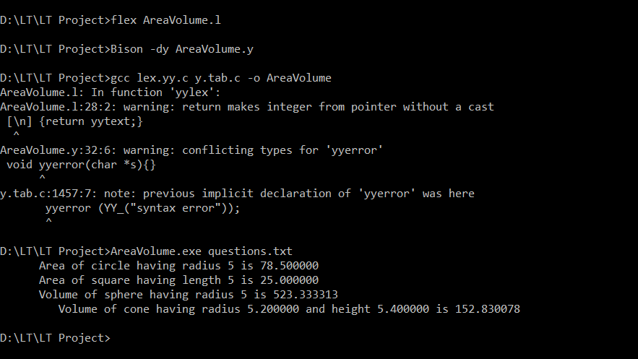
OUTPUT 1

Slide 7
questions.txt(With Error)
find area of circle having radius 5
find area of square having length 5
find volume of sphere having radius 5
fid volume of cone having radius 5.2 and height 5.4

Slide 8
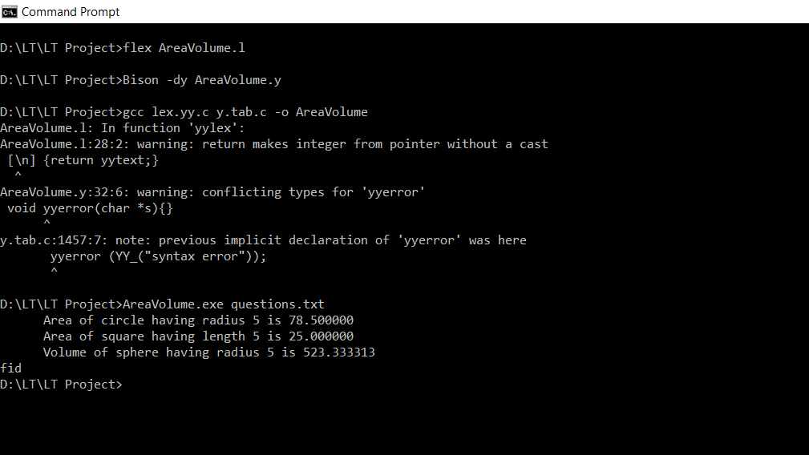
OUTPUT 2

